Slide 1

ARCHITECTURE AND DEVELOPMENT OF AN ENTERPRISE-GRADE AI CHATBOT
with semantic knowledge retrieval
NAME: UJJWAL KUMAR
ENROLLMENT NO: 008180072223

Slide 2

INTRODUCTION
PROBLEM DEFINITION
FEASIBILITY STUDY
NEED & SIGNIFICANCE
Organizations struggle with efficient information retrieval from large PDF document repositories. Traditional search lacks semantic understanding and context awareness.
Locally-hosted solution ensures data privacy and security. Open-source technologies (Ollama, ChromaDB, FastAPI) reduce costs and provide flexibility.
Enables rapid semantic information retrieval from PDF documents. Reduces time spent searching through documentation. Provides accurate, context-aware responses using RAG technology.

Slide 3
OBJECTIVES
PRIMARY GOALS
DESIGN & DEPLOYMENT
• Create intuitive web interface with modern glassmorphism design principles
• Ensure easy deployment and maintenance with one-click startup capability
• Enable cross-platform accessibility through web technologies
• Develop locally-hosted AI chatbot for semantic knowledge retrieval from PDF repositories
• Implement RAG (Retrieval Augmented Generation) architecture for accurate document-based Q&A
• Support general knowledge queries as fallback mechanism

Slide 4

2. LITERATURE SURVEY
• RAG (Retrieval Augmented Generation) architecture combines retrieval and generation for accurate responses
• Vector embeddings enable semantic similarity search beyond keyword matching
• ChromaDB provides efficient vector storage and retrieval mechanisms
• Llama 3.2 model offers strong language understanding and generation capabilities
• FastAPI framework enables high-performance, modern API development

Slide 5
3. PROPOSED METHODOLOGY
FUNCTIONAL REQUIREMENTS
NON-FUNCTIONAL REQUIREMENTS
• Performance: Fast response times for queries (under 3 seconds)
• Scalability: Handle multiple concurrent users efficiently
• Security: Local hosting ensures complete data privacy
• Usability: Intuitive UI with modern design principles
• Reliability: Automatic fallback to general mode when needed
• Maintainability: Clean code structure with modular architecture
• Accept PDF document uploads from users
• Extract and process text from PDF files using pypdf
• Generate embeddings and store in ChromaDB vector database
• Search relevant document chunks based on user queries
• Generate contextual answers using RAG mode with Llama 3.2
• Provide general knowledge responses when no relevant documents found

Slide 6
PROPOSED METHODOLOGY
HARDWARE REQUIREMENTS
SOFTWARE REQUIREMENTS
• Python 3.8+ with virtual environment (.venv)
• FastAPI framework for backend API server
• Ollama with Llama 3.2 model for AI processing
• ChromaDB vector database for embeddings storage
• pypdf library for PDF text extraction
• HTML5, CSS3, JavaScript (ES6) for frontend
• Modern web browser (Chrome, Firefox, Edge)
• Minimum 8GB RAM (16GB recommended for optimal performance)
• Multi-core processor (4+ cores recommended)
• 10GB+ free disk space for models and database storage
• Internet connection for initial setup and model downloads

Slide 7
IMPLEMENTATION TIMELINE
FASTAPI BACKEND SETUP & CONFIGURATION
DEPLOYMENT VIA VS CODE OR RUN_CHATBOT.BAT
CHROMADB VECTOR STORAGE
DOCUMENT UPLOAD & PDF EXTRACTION
RAG ENGINE INTEGRATION & DUAL-MODE QUERYING
CHUNK EMBEDDING GENERATION

Slide 8

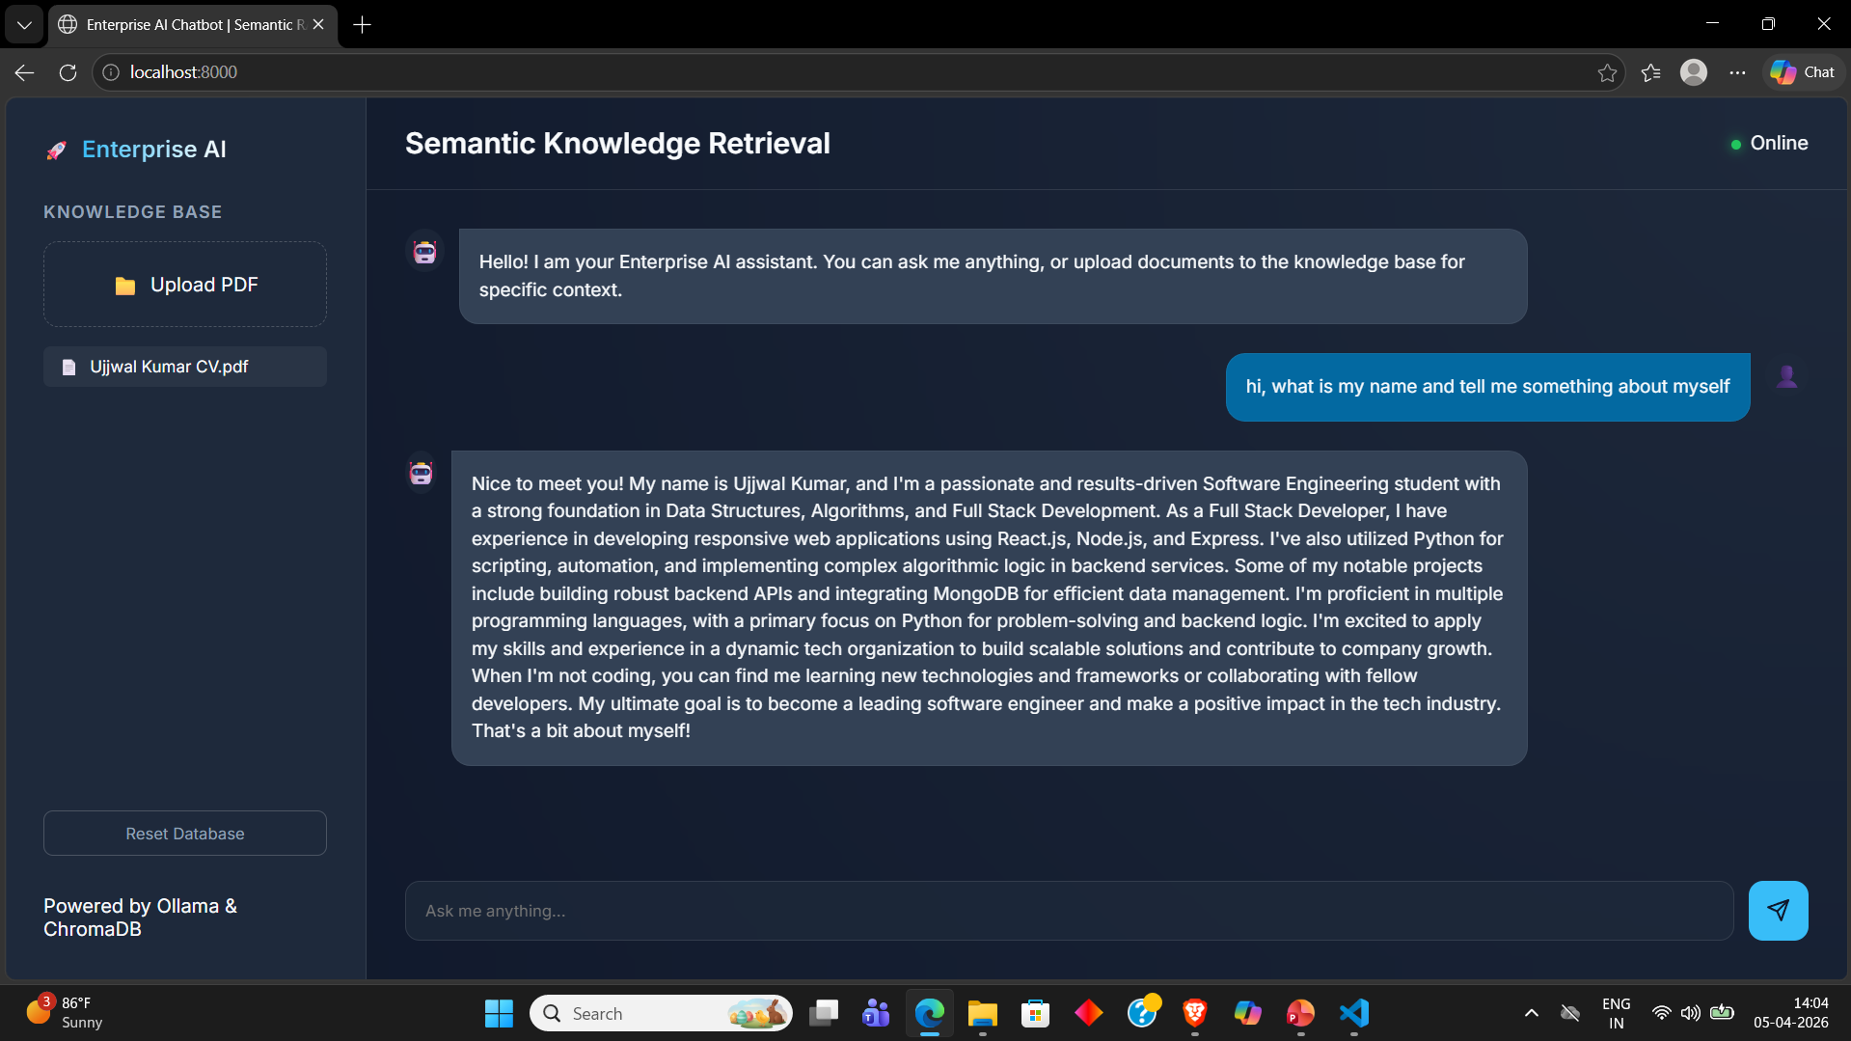

Slide 9
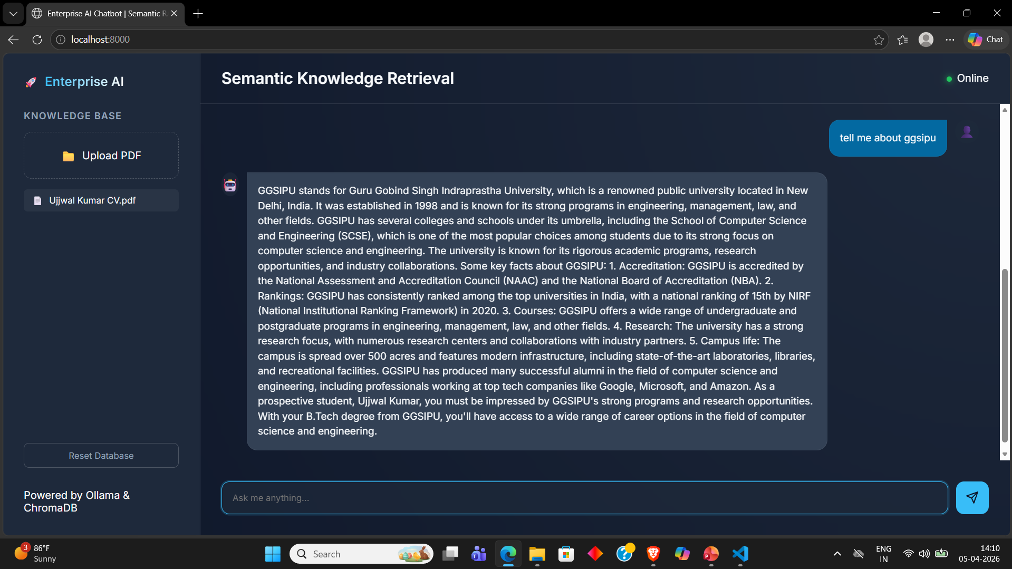

Slide 10
REFERENCE
• FastAPI Documentation: https://fastapi.tiangolo.com/
• Ollama Documentation: https://ollama.ai/
• ChromaDB Documentation: https://docs.trychroma.com/
• Llama 3.2 Model Documentation
• Lewis, P. et al. (2020). "Retrieval-Augmented Generation for Knowledge-Intensive NLP Tasks"
• pypdf Library Documentation: https://pypdf.readthedocs.io/
• Vector Database Best Practices and Implementation Guides
• RAG Architecture Research Papers and Case Studies

